Slide 1
BANKRUPTCY PREVENTION

Slide 2
BUSINESS OBJECTIVE
• The fundamental goal here is to model the probability that a business goes bankrupt.
• To predict the likelihood of a company going bankrupt based on the provided features: industrial risk, management risk, financial flexibility, credibility, competitiveness, and operating risk.
• Data-driven insights can help identify early warning signs and provide guidance for strategic decision-making

Slide 3
DATA SET INFORMATION:
The data set contains 7 columns about 250 rows:
1. Industrial risk: 0=low risk, 0.5=medium risk, 1=high risk.
2. Management risk: 0=low risk, 0.5=medium risk, 1=high risk.
3. financial flexibility: 0=low flexibility, 0.5=medium flexibility, 1=high flexibility.
4. credibility: 0=low credibility, 0.5=medium credibility, 1=high credibility.
5. competitiveness: 0=low competitiveness, 0.5=medium competitiveness,
1=high competitiveness.
6. Operating risk: 0=low risk, 0.5=medium risk, 1=high risk.
7. class: bankruptcy, non-bankruptcy (target variable).

Slide 4
EXPLORATORY DATA ANALYSIS (EDA)
Data Cleaning: Removed duplicate entries to ensure the dataset's integrity and prevent bias in model training.
Outlier Detection: Checked for outliers in the dataset and handled them appropriately to avoid skewing model performance.
Handling Categorical Variables: Applied label encoding to convert categorical variables into numerical values for compatibility with machine learning algorithms.
Correlation Analysis: Generated a correlation matrix to identify relationships between variables and detect multicollinearity.
Missing Value Treatment: Checked for any missing data and handled it appropriately to ensure consistency in the dataset.
Visualization: Created visualizations such as heatmaps, bar plots, and pair plots to gain insights into variable distributions and relationships.

Slide 5
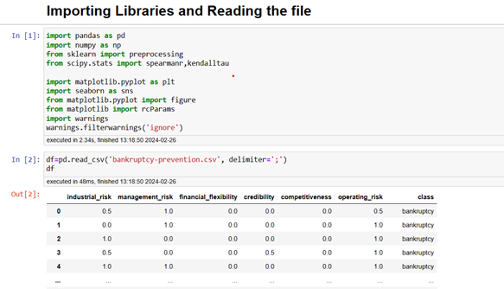
AGENDA
Step1: Importing libraries and Reading file:

Slide 6
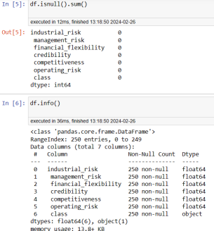
⮚ Checking Data types and Null values:

Slide 7
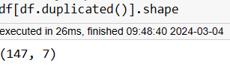
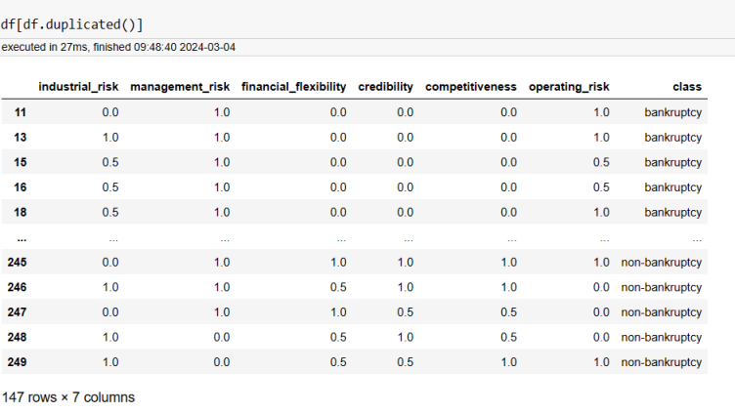
Checking duplicate values :
Count of duplicated rows:
We have 147 rows and 7 columns count,

Slide 8
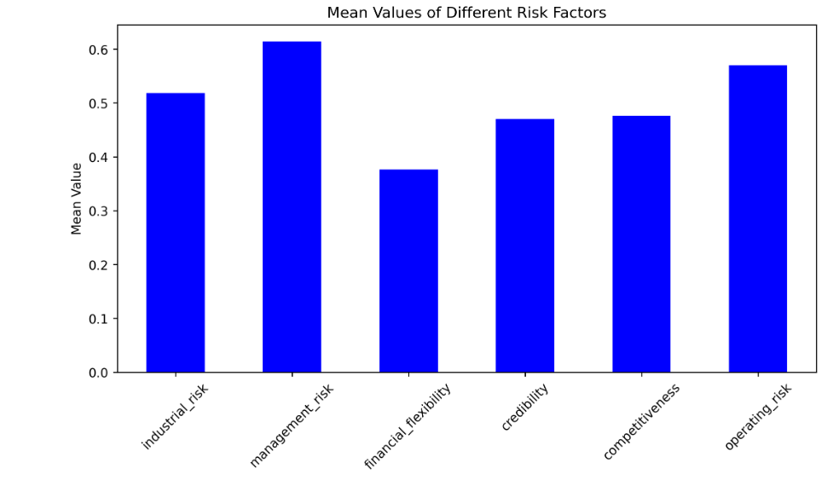
MEAN VALUES OF DIFFERENT RISK FACTORS
Management Risk has the highest average value, slightly exceeding 0.6. This suggests that, on average, the management risk is relatively high compared to the other risk factors.
Operating Risk comes next with a mean value just above 0.5, indicating that operational concerns are also a prominent risk factor.
Industrial Risk has a mean value around 0.5, which signifies a moderate level of exposure to industrial-related risks. This is in line with management and operational risks, indicating that businesses face substantial challenges both at the management and industrial levels.
Credibility and Competitiveness have nearly identical mean values, both close to 0.4.
Financial Flexibility has the lowest mean value, slightly above 0.3

Slide 9
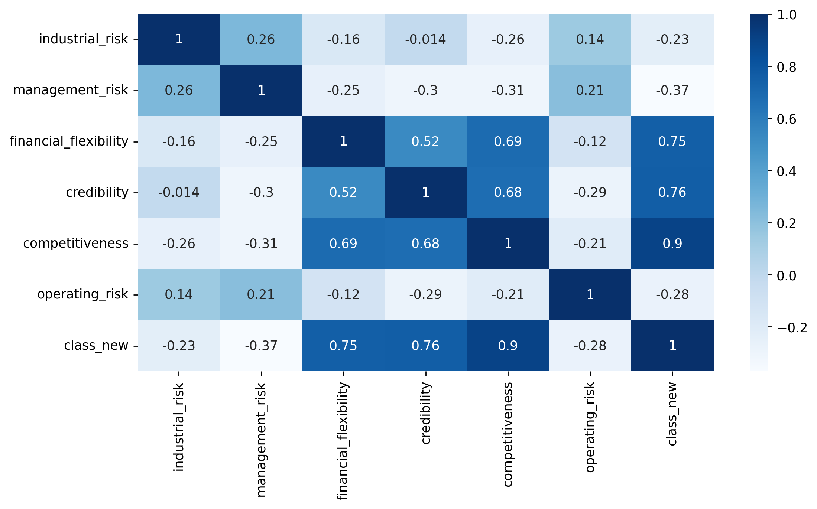
Correlation of Heatmap
Strong Positive Correlation:
Financial flexibility, competitiveness, and credibility are strongly positively correlated with each other.
Strong Negative Correlation:
Management risk is negatively correlated with credibility and competitiveness, so improvements in credibility and competitiveness may reduce management risk.

Slide 10
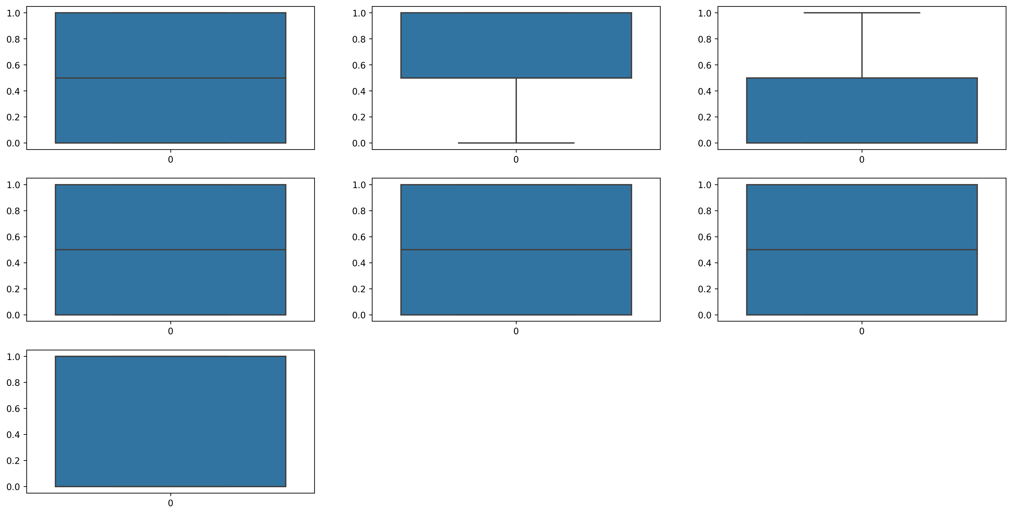
BOXPLOT FOR WHOLE DATASET
It indicating no outliers are detected in a data set

Slide 11
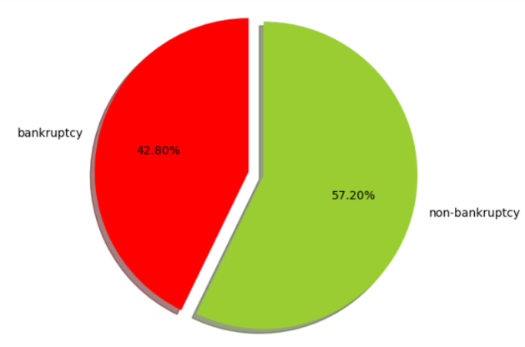
PIE CHART
It shows that around 42.80% columns indicating bankruptcy and
57.20% indicates non bankruptcy

Slide 12
Model Building
We Fitted Five Machine Learning Models to the data given below:
• Logistic Regression
• Random Forest
• KNN Classifier Model
• Decision Tree
• SVC

Slide 13
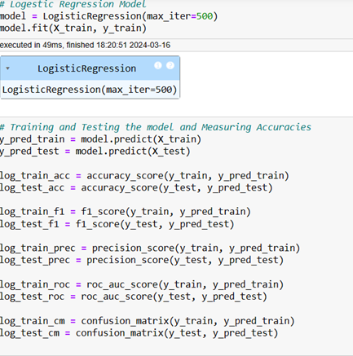
1. LOGISTIC REGRESSION • The accuracy achieved in Logistic Regression is 100%

Slide 14
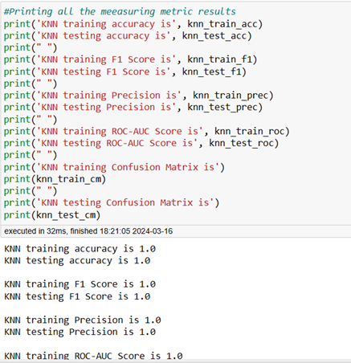
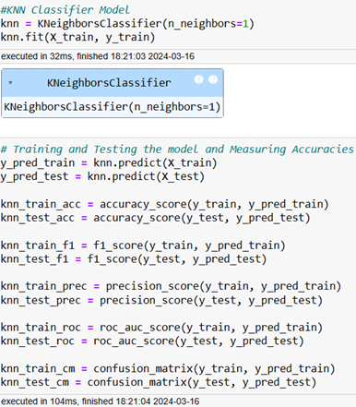
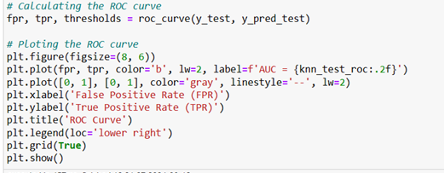
3. KNN CLASSIFIER MODEL:
KNN training ROC-AUC Score is 1.0
KNN testing ROC-AUC Score is 1.0
Calculating ROC Curve :

Slide 15
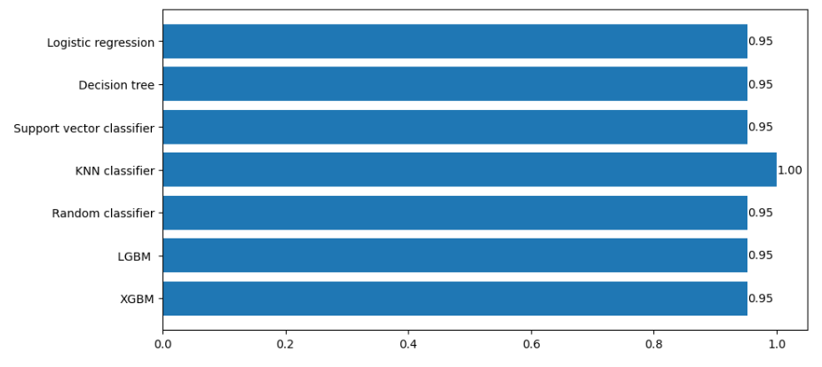
COMPARISION OF DIFFERENT MODELS
So KNN is giving good accuracy as compared to other model, hence we are using it for Model deployment purposes

Slide 16
MODEL DEPLOYMENT
"We deployed the KNN model using Streamlit, creating an interactive web application for real-time predictions and insights.
The KNN model provides 100% accuracy, outperforming other models that gave 95% accuracy. This user-friendly interface allows for easy data input and visualization, making it a powerful tool for showcasing model outputs and supporting decision-making."

Slide 17
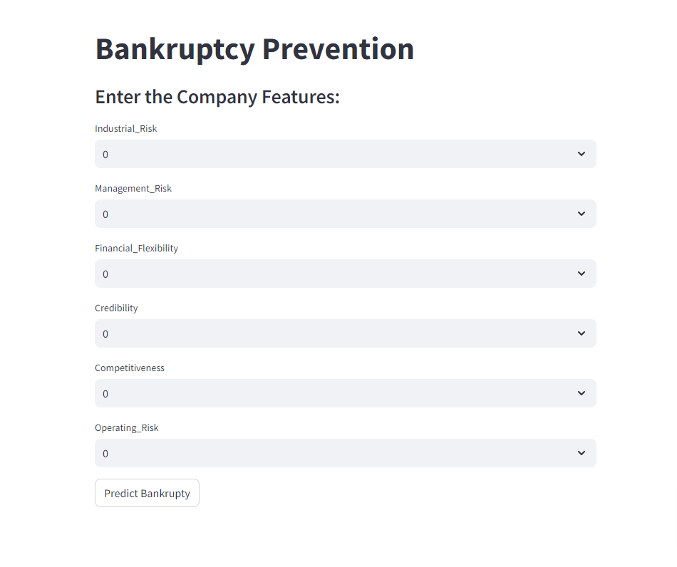

Slide 18
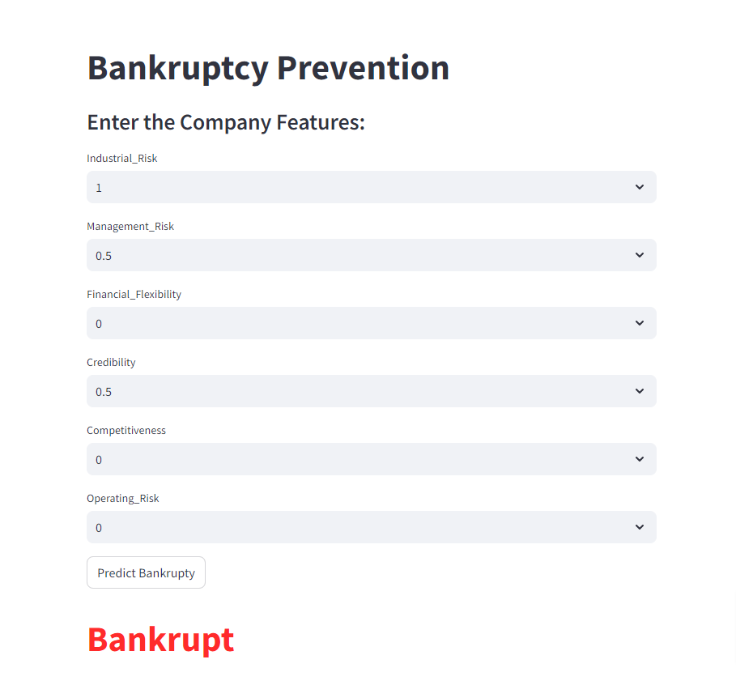

Slide 19
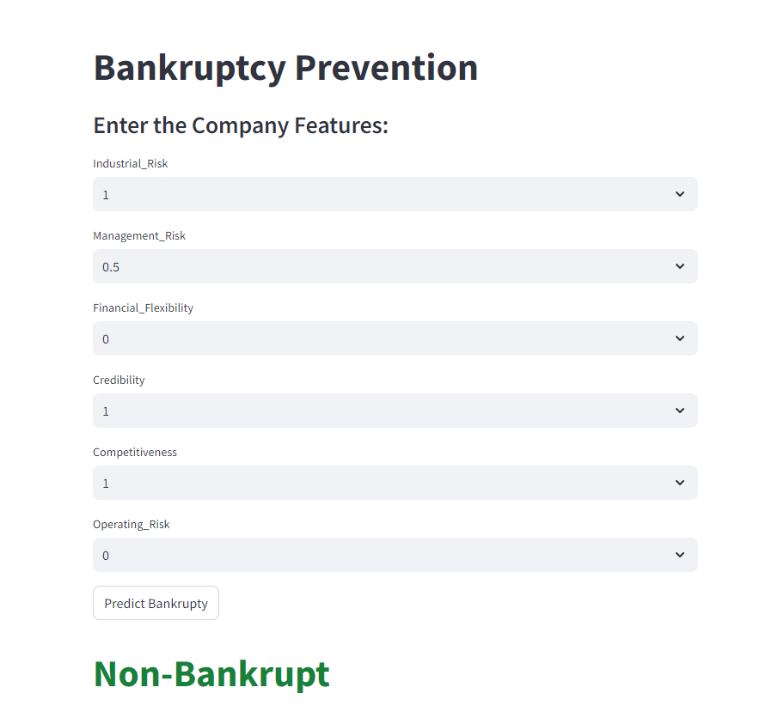

Slide 20
TOOLS AND TECHNOLOGIES USED
During the internship, a variety of tools and technologies were used to complete the project, including:
Python (for data manipulation and model building)
Pandas and NumPy (for data handling)
Matplotlib and Seaborn (for data visualization)
Scikit-learn (for machine learning)
Streamlit (for deploy)
These tools enabled efficient handling of data and the development of a robust predictive model.

Slide 21
CHALLENGES FACED WHILE DOING PROJECT & HOW DID YOU OVERCOME IT.
Handling Categorical Variables: One challenge was dealing with categorical data. To address this, we applied label encoding to convert the categories into a numerical format suitable for model training.
Choosing Appropriate Evaluation Metrics: Selecting the right evaluation metrics was crucial for accurately assessing model performance. We utilized precision, recall, and the ROC curve to ensure a comprehensive evaluation.
Platform Selection for Deployment: Choosing a platform for deployment was another challenge. We resolved this by deploying the model on Streamlit, which offered a user-friendly interface and free hosting capabilities.

Slide 22
CONCLUSION
"In this project, we successfully developed a predictive model for bankruptcy prevention using various machine learning techniques.
The KNN model demonstrated superior performance with 100% accuracy, surpassing other models.
By deploying the model via Streamlit, we created a user-friendly application for real-time predictions.
This tool will help businesses identify early bankruptcy risks, supporting informed decision-making and strategic planning."

Slide 23
THANK YOU

